Slide 1
Recurrent Neural Networks as Cognitive Models
Master’s Thesis Project
Rishubh Singh
Prof. Sumeet Agarwal

Slide 2
Motivation
Model neural networks can reproduce important features of neural activity recorded in cortical areas of animals.
The analysis of such circuits, whose activity and connectivity are fully known, has therefore re-emerged as a promising tool for understanding neural computation.
Constraining network training with tasks for which detailed neural recordings are available may also provide insights into the principles that govern learning in biological circuits.
Early works on Deep Learning : Hebbian Learning, the Perceptron were biologically inspired.
Research moved away from biological inspiration to engineering and main goal was efficiency.
Existing RNNs lack basic biological features.
Trained networks achieve same behavioral performance but differ greatly in structure, dynamics and learning (task design).

Slide 3
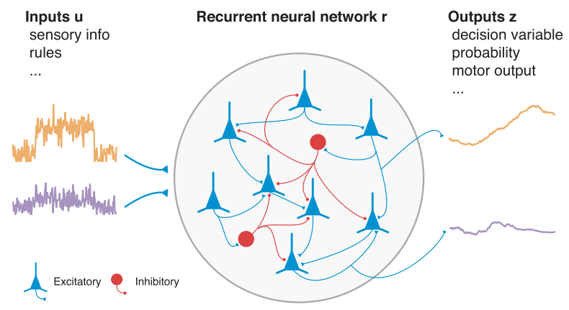
Training Excitatory-Inhibitory RNNs for Cognitive Tasks
Perpetual decision making
Context dependent integration
Parametric working memory
Eye-movement sequence execution
All of these are low level tasks that are trained and tested at the level of neural data.
H. Francis Song
Guangyu R. Yang
Xiao-Jing Wang
Training Excitatory Inhibitory RNNs for Cognitive Tasks: Song, Yang, Wang, PLOS 2016

Slide 4
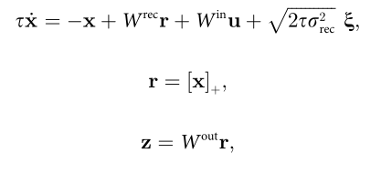
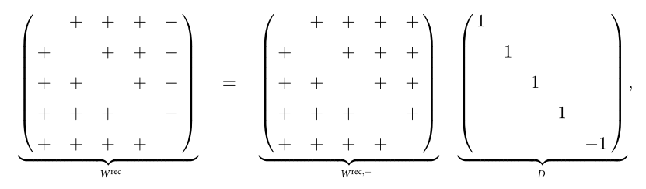
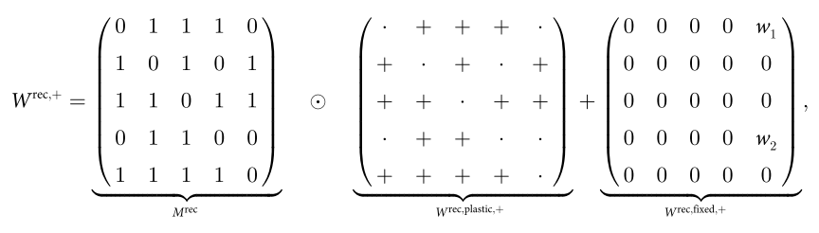
RNN describing equations :
Dale’s principle :
Pattern of connectivity :

Slide 5
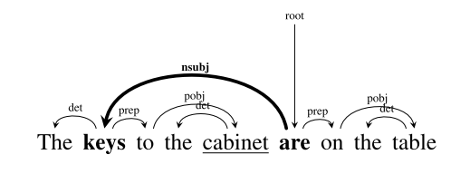
Assessing the Ability of LSTMs to Learn Syntax-Sensitive Dependencies
Tal Linzen
Emmanuel Dupoux
Yoav Goldberg
Assessing the Ability of LSTMs to Learn Syntax-Sensitive Dependencies: Linzen, ACL 2016

Slide 6
Syntax-Sensitive Dependencies
The pan is on the stove.
* The pans is on the stove.
* The pan are on the stove.
The pans are on the stove.
The pan from the cupboard is on the stove.
The keys to the cabinet are on the table.
The decision of female Gothic writers to supplement true supernatural horrors with explained cause and effect transforms romantic plots and Gothic tales into common life and writing.
Assessing the Ability of LSTMs to Learn Syntax-Sensitive Dependencies: Linzen, ACL 2016
Notes:
3 mins

Slide 7
Number Prediction Task
The model sees the sentence up to but not including a present-tense verb.
The model then needs to predict the number of the following verb.
Example : The pan from the cupboard ________
Concepts Needed :
Syntactic number : words are singular and plural
Syntactic subjecthood : identify the subject corresponding to the verb

Slide 8
Corpus Statistics
 | With Attractors | With Intervening Nouns
N = 0 | 92.7% | 80.8%
N = 1 | 5.7% | 12.7%
N = 2 | 1.1% | 4.2%
N = 3 | 0.3% | 5.1%
N = 4 | 0.1% | 2.1%
Corpus statistics of the number agreement test dataset (1.5M sentences) by Linzen et al

Slide 9
Inflection Task
The model sees the sentence up to and including the singular form of a present-tense verb.
The model then needs to predict the number of the following verb.
Example : The pans from the cupboard is
Access to semantics of verb can help network identify corresponding verb :
People from the capital often eat pizza.

Slide 10
Grammaticality Task
Half of the examples in the corpus are made ungrammatical by flipping the number of the verb.
The network reads the entire sentence and receives a supervision signal at the end.
The key to the cabinet is on the stove.
* The keys to the cabinet is on the stove.
Previous objectives :
Explicitly indicate location of the sentence in which the verb can appear.
Gives the network a cue to syntactic clause boundaries.
Explicitly direct the networks attention to the number of the verb.
This task :
Weaker supervision : complete sentence given to judge if it is grammatical.

Slide 11
Generic Models
Words are encoded as one-hot vectors, embedded in a 50-dimensional vector space.
Final state of the network is fed into a logistic regression classifier.
We pass the final state to a fully connected layer to produce two outputs.
Final prediction : label with the higher output.
The input sentence is pre-padded with zeros to a fixed length of 50.
The model is then trained in an end-to-end fashion, including the word embeddings.
Notes:
6 mins

Slide 12
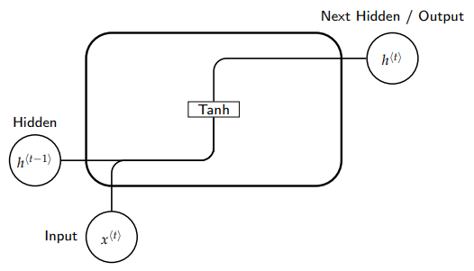
SRN / Standard RNN

Slide 13
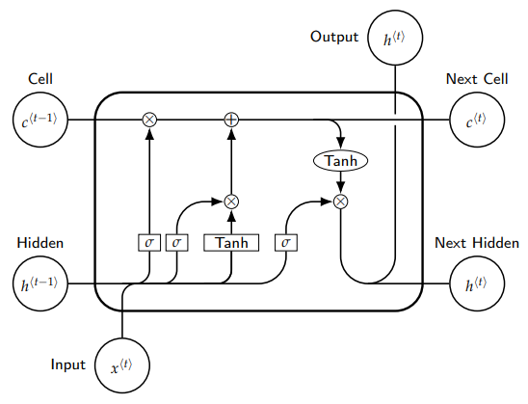
LSTM

Slide 14
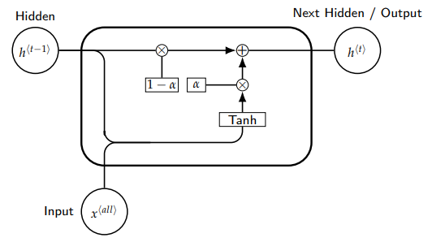
EIRNN

Slide 15
EIRNN
(hidden_units * hidden_units)
W_{in}
W_{out}
Softmax
(hidden_units * len)
(output_units * hidden_units)
W_{rec}
Input Sentence
(len * emb_dim)
Output Sequence
Recurrent Part
All results that follow are from the best performing model with parameters :
hidden_units = 15
input_units = max sentence length = 50
output_units = 10

Slide 16
Performance
Model | Overall Accuracy (%)
EIRNN (H = 3) | 92.8
EIRNN (H = 15) | 94.1
EIRNN (H = 50) | 93.5
RNN | 97.7
RNN Dale | 97.8
AbLSTM | 98.0
LSTM | 98.7
Model | Overall Accuracy (%)
EIRNN (H = 3) | 92.5
EIRNN (H = 15) | 94.2
EIRNN (H = 50) | 93.3
RNN | 97.9
RNN Dale | 98.0
AbLSTM | 98.1
LSTM | 98.9
On Number Prediction
On Inflection

Slide 17
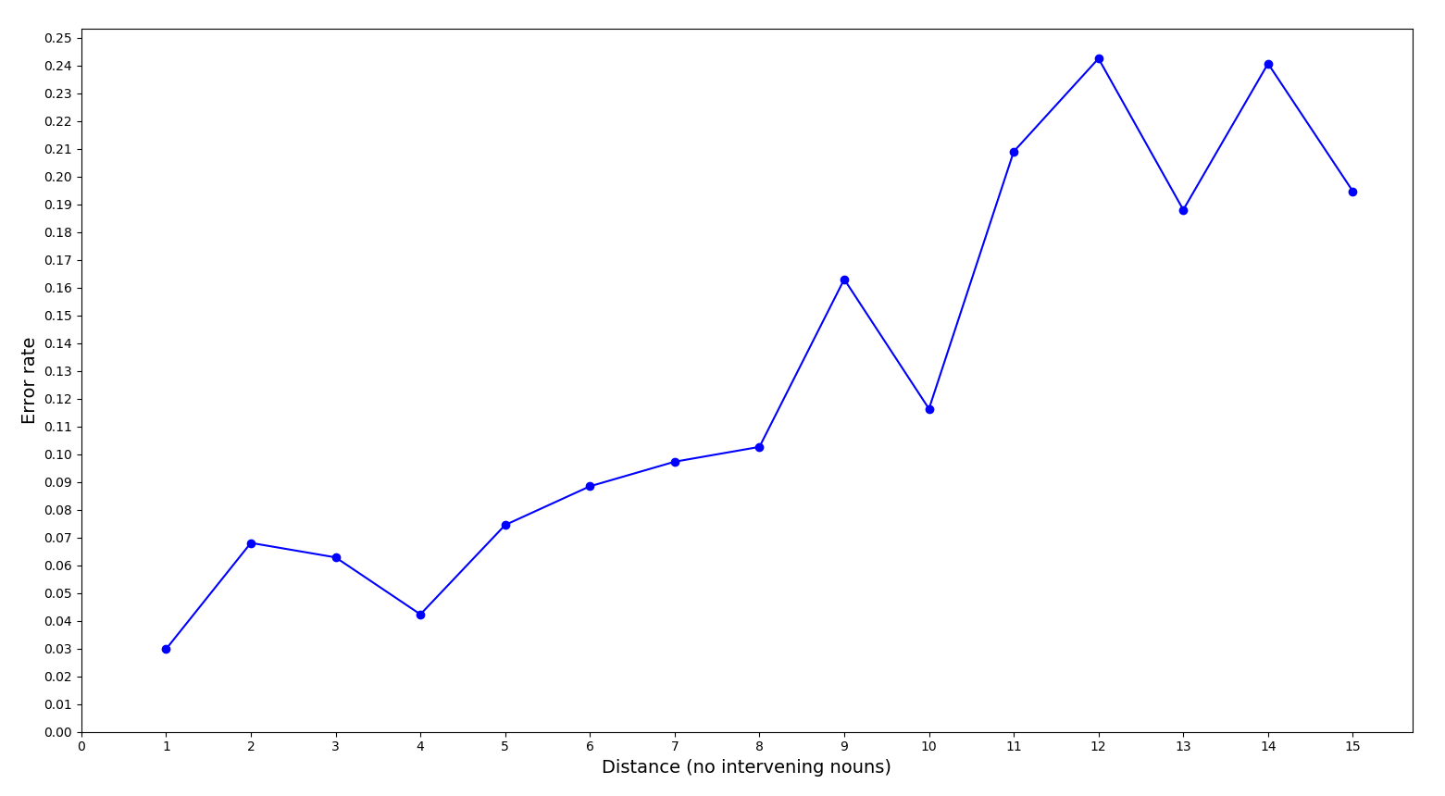
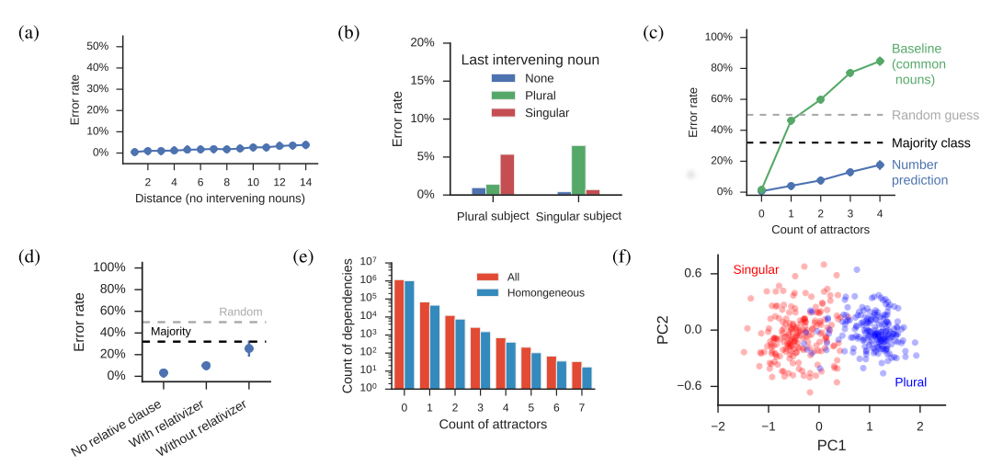
Error Rate : With increasing distance with no intervening nouns
EIRNN
LSTM
Assessing the Ability of LSTMs to Learn Syntax-Sensitive Dependencies: Linzen, ACL 2016

Slide 18
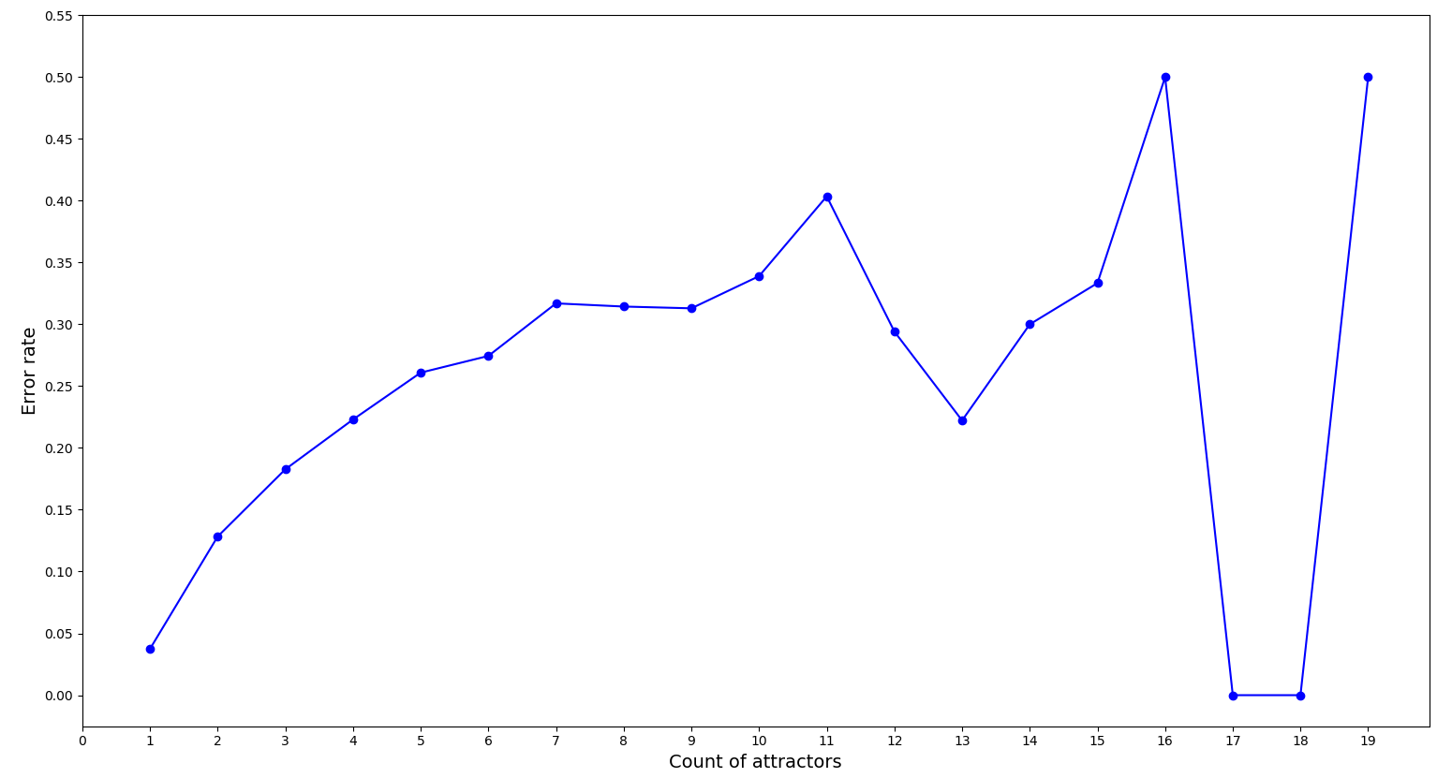
Error Rate : With increasing number of attractors between noun and verb
EIRNN
LSTM
Assessing the Ability of LSTMs to Learn Syntax-Sensitive Dependencies: Linzen, ACL 2016

Slide 19
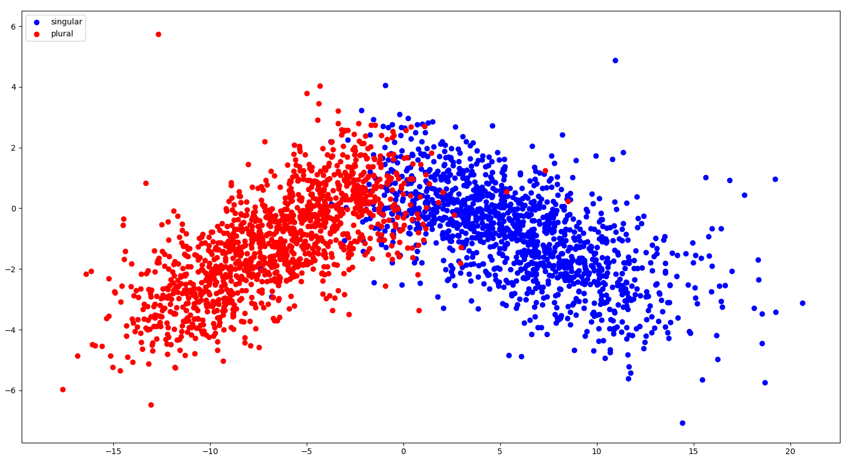
EIRNN :Word Embeddings Projected on first two PCs

Slide 20
EIRNN vs LSTM
 | No Last Intervening | Singular Last Noun | Plural Last Noun
Singular Subject | 2.14 (0.31) | 2.95 (0.48) | 41.03 (3.93)
Plural Subject | 7.15 (1.67) | 44.43 (7.53) | 5.74 (1.86)
EIRNN (LSTM)

Slide 21
EIRNN not LSTM | LSTM not EIRNN
2272 unique ; 13941 total points NN : 3368 NNS : 1470 NN NN : 1177 NN NNS : 432 NNP NN : 349 NN NN NN : 315 PRP$ NN : 298 NN NNP : 213 NNP NNS : 187 NNS NNS : 175 NNS NN : 168 PRP NN : 135 PRP$ NNS : 125 NNP NN NN : 123 NN NN NN NN : 119 | 23313 unique ; 84039 total points NNS NN : 5758 NN NNS : 5619 NN NN NNS : 2619 NNS NN NN : 2092 NNS : 1997 NN NNS NN : 1295 NN NN NN NNS : 1053 NN : 954 NN NNS NNS : 841 NNP NN NNS : 602 NNS NNS NN : 597 NNS NN NN NN : 594 NNS NNP NNP : 576 NNS NNP NN : 496 NN NNP NNS : 486

Slide 22
Grammaticality Performance
Model | Accuracy (%age)
EIRNN (15) | ~ 50
EIRNN (3) | ~ 50
RNN | ~ 50
RNN (Dale) | ~ 50
LSTM (50) | 4.5
LSTM (3) | ~ 60
Ablated LSTM (scalar) | ~ 50
Ablated LSTM (vector) | ~ 50
Notes:
10 mins

Slide 23
Notes:
Marks end of Sem 1

Slide 24
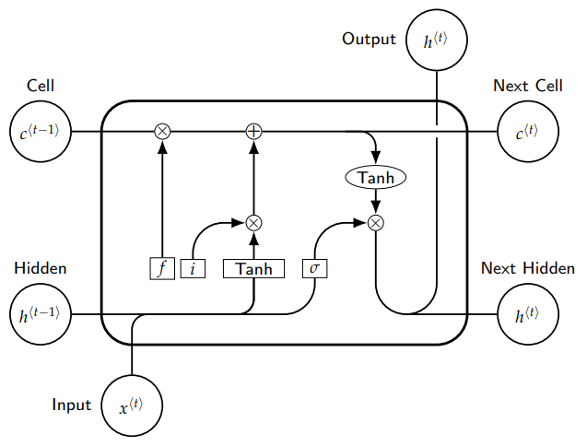
Ablated LSTM : AbLSTM

Slide 25
Grammaticality on Half Sentences
The key to the cabinet is
* The keys to the cabinet is
Model | Accuracy (%age)
EIRNN (3) | 84.3
EIRNN (15) | 88.3
EIRNN (50) | 86.3
RNN (Dale) | 97.8
AbLSTM | 97.1
LSTM | 98.3

Slide 26
Grammaticality Plus
Variable α (alpha) specifies the maximum number of words in the input sentence after the verb that is in context in the sample. The set of tasks is collectively termed Grammaticality Plus.
α = 0 : The version of the chronicle that the annalists were working was written in different places at different times; the earliest evidence for one of its authors places
α = 3 : The version of the chronicle that the annalists were working was written in different places at different times; the earliest evidence for one of its authors places it in Iona
α = 6 : * The version of the chronicle that the annalists were working was written in different places at different times; the earliest evidence for one of its authors place it in Iona sometime after 563

Slide 27
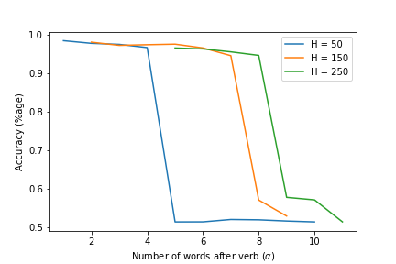
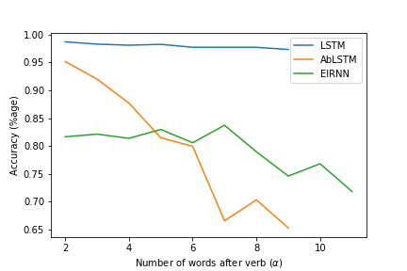
Performance Comparison
RNN
LSTM, AbLSTM and EIRNN

Slide 28
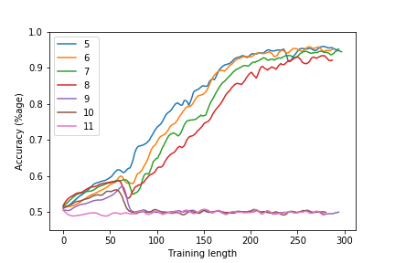
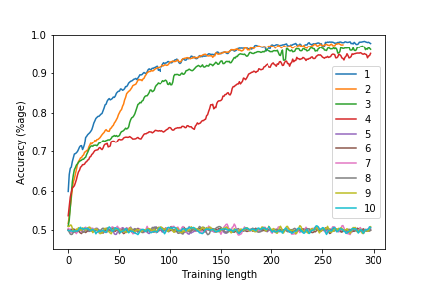
Validation Accuracy Curves During Training
RNN (H = 250)
RNN (H = 50)

Slide 29
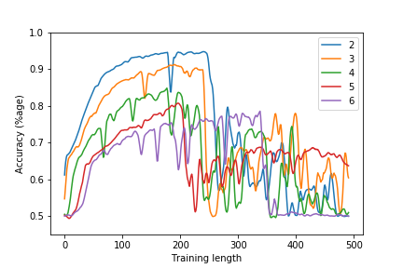
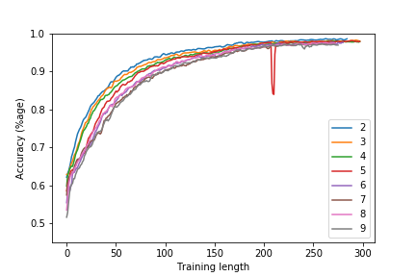
AbLSTM
LSTM

Slide 30
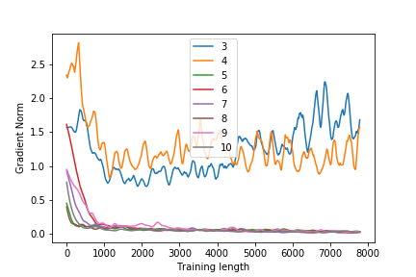
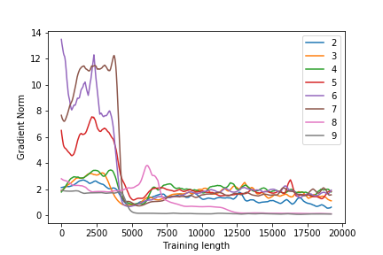
Gradient Norm Plots
RNN (H = 50) : W_{rec}
RNN (H = 150) : W_{rec}

Slide 31
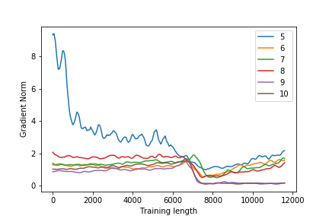
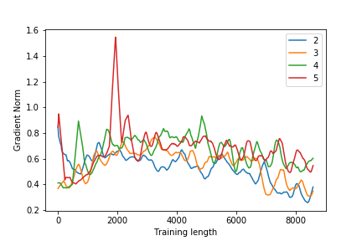
RNN (H = 250) : W_{rec}
LSTM : W_{rec}

Slide 32
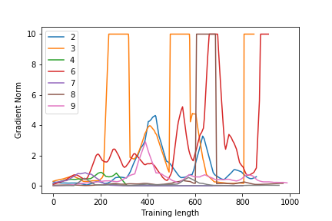
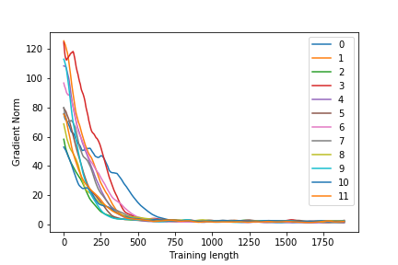
AbLSTM W_{rec}
EIRNN W_{rec}

Slide 33
Networks’ Prediction Change Plots

Slide 34
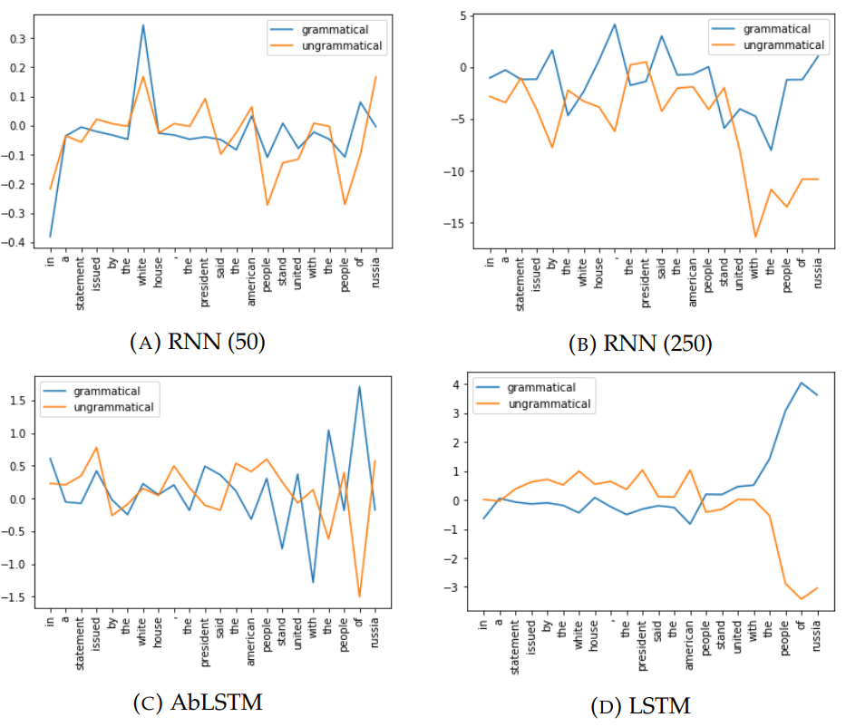
Plus 6
In a statement issued by the white house, the president said the American people stand united with the people of Russia

Slide 35
Qualitative Analysis
We manually examined over 500 samples to compare LSTM and RNN modelling results on multiple Grammaticality Plus tasks. Statistics for these results have been summarized in Table below.
 | Plus 2 | Plus 3 | Plus 6
Both Correct | 96.7% | 96.4% | 95.0%
Only LSTM Correct | 1.7% | 1.8% | 2.9%
Only RNN Correct | 0.8% | 1.1% | 1.2%
Both Wrong | 0.7% | 0.7% | 0.9%
Overall Accuracy
Plus 2, 3 : RNN (H = 50) and Plus 6 : RNN (H = 250)

Slide 36
The networks often misidentified the heads of noun-noun compounds.
* Two relatively large football stadiums , Fawcett stadium in Canton and Paul Brown Tiger stadium in Massillon , is still in use
Tax collectors collect gold from guilds
* The credits sequence of Bob’s Burgers feature the Belcher family
The urban services district encompasses the 1963 boundaries of the former city of Nashville , and the general services district includes the remainder of

Slide 37
Lack of syntactic boundaries makes identifying the noun-verb pair correctly hard. The difficulty increases with addition of more noun-verb pairs, before the noun in context or in between the noun-verb pair on which the sample is testing grammaticality.
I believe that the usual way a tachometer works is by spinning a
* The region where the stream originates are in the highlands
* The state that the narrator wants are seemingly a state

Slide 38
Understand inherent plurality introduced by group creation by using "commas" and conjunctive words likes "and" and "plus", is hard and in such cases the head of the subject’s number may not be relevant.
* Corn , soybeans, and wheat is three common crops
Characters and plot are complementary – they
* Health , arts and imaging technology, respiratory care and dental hygiene is some of the

Slide 39
Ability of the model to distinguish proper nouns from other nouns when the sentence in lower case which removes one of the major clues present in general in text.
The United States system requires that these differences
* The credits sequence of Bob’s Burgers feature the Belcher family
* The Blocks editor use the Open Blocks software

Slide 40
Quantitative Analysis
50% of the samples which LSTM gets wrong, AbLSTM also gets wrong across multiple Plus α tasks. On the other hand, RNN only gets around 20-30% samples wrong which LSTM predicted incorrectly. The above correlation shows that :
Architectural closeness between AbLSTM and LSTM is reflected in behavioral (performance) closeness.
The high correlation is errors made by different models shows that some sentences are inherently harder to model than others
 | Plus 2 | Plus 3
Both Correct | 2.35 | 2.35
Only LSTM Correct | 5.72 | 5.3
Only RNN Dale Correct | 5.0 | 4.63
Both Wrong | 6.81 | 6.58
Average distance between noun and verb for each set

Slide 41
Expectation and Locality Effects
Expectation Effect :
The expectation for a verb becomes sharper in the second case, leading to faster reading times at the verb compared to the first sentence. (Distance between noun phrase and verb increased).
The administrator who the nurse met…
The administrator who the nurse that was from the clinic met…
Locality Effect :
Grodner and Gibson showed that increasing distance in the manner shown above results in slowdowns at the verb. This has been explained in terms of the increased cost of completing a dependency when a co-dependent is more distant.
The argument is difficult to retrieve either because it has become less accessible in memory over time (decay), or because other nouns intervening between the co-dependents make it difficult to identify and retrieve the correct target noun .
S Husain 2014, Strong Expectations Cancel Locality Effects: Evidence from Hindi
Grodner and Gibson, Consequences of the Serial Nature of Linguistic Input for Sentenial Complexity

Slide 42
Comparison Across Plus Tasks on a Model
Compared the performance and specific errors of :
RNN on Plus 1 and Plus 3
LSTM on Plus 3 and Plus 6
Contrary to expectation :
Errors made by RNN on Plus 1 are not a subset of errors made on Plus 3.
Errors made by LSTM on Plus 3 are not a subset of errors made on Plus 6.
The overlap of errors in both above cases is close to 40-45%.
More than 50% of samples wrong in one were right in the other.
Although the overall performance decreases with increasing α, the errors made by the network are not consistent.
These results agree with the expectation vs locality effect trade-offs in linguistics and cognition.
The added words in other cases help the network better parse the sentence.

Slide 43
Potential Plus 3 sample :
The apartment that the maids who the service had sent over were cleaning every week…
Potential Plus 6 sample :
The apartment that the maid who the service had sent over were cleaning every week was well decorated.
Hypothesis :
It is harder to find noun-verb associations in the first sentence than in the second because of the extra information present.
The locality like effect of having a cue about the locus of the verb vs the expectation like effect of having extra information helping parsing/correctly identifying noun-verb pairs.

Slide 44
Discussion on Ablated LSTM
Networks with high accuracy on grammaticality :
LSTM
Combined i-f gate LSTM
GRU
Hypothesis :
Input and forget gates are important to the performance of the LSTM, not just for better gradient flow.
LSTMs (GRUs, etc) performing better on natural language tasks shows that being able to selectively remember and forget is needed for language comprehension.

Slide 45
Discussion
Comparison of different recurrent models of different linguistic tasks can provide insights into both cognition and understanding how architecture affects performance.
Since the majority of natural language sentence are grammatically simple, models can achieve high overall accuracy using flawed heuristics that fail.
The reason behind the inability of SRN or RNN Dale to suddenly be unable to model a task with slightly higher difficulty (alpha increased by 1) is unclear.
Syntax Trees vs Sequential Parsing.
LSTM : Model Brain or Model Brain Function.

Slide 46
Conclusion
We analyzed the performance of architecturally plausible neural networks with explicit biological constraints.
We provided insights into differences in different recurrent neural networks and factors that affect them.
We showed relationships between different tasks based syntax-sensitive dependencies and that more information can both help and hurt in a linguistic setting.
We proposed insights that inspire models that are biologically plausible and can bridge the gap between in architecture when we talk of cognitive plausibility

Slide 47
Future Work
Further analysis of the activation plots and different models that are more powerful than AbLSTM but less powerful than LSTM would shed further light on how architecture affects learning in LSTMs and in recurrent neural networks in general.
Changing the recurrent network to use the last two states instead of just one reduces the effective distance between two points in the sequence in half which could help in modelling.
LSTMs with explicit window memories to access previous states/inputs could explain explicit vs implicit memory effects.
This would also help in sentences in which the parse of the sentence cannot be created by reading words only sequentially.
Further linguistic analysis on the corpus and the error sets of the models across multiple tasks would provide more concrete evidence.

Slide 48
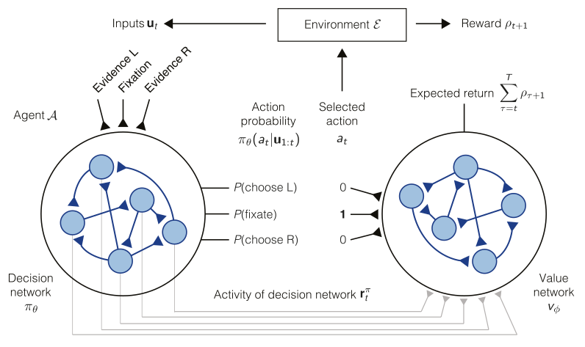
Reward-based Training of RNNs for Cognitive & Value-based Tasks
Decision & Value Networks (Actor-Critic structure)
Pre/post decision wagering.
Perpetual decision making.
Value-based economic choice.
All of these are low level tasks that are trained and tested at the level of neural data.
H. Francis Song
Guangyu R. Yang
Xiao-Jing Wang
Reward-based training of recurrent neural networks for cognitive and value-based tasks: Song, Yang, Wang, PLOS 2017

Slide 49
Thank You!
Rishubh Singh

Slide 50
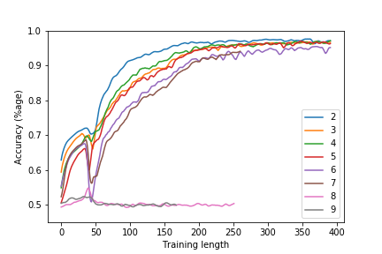
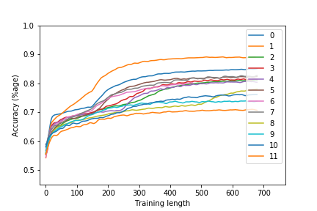
Validation Accuracy Curves During Training
RNN (H = 150)
EIRNN

Slide 51
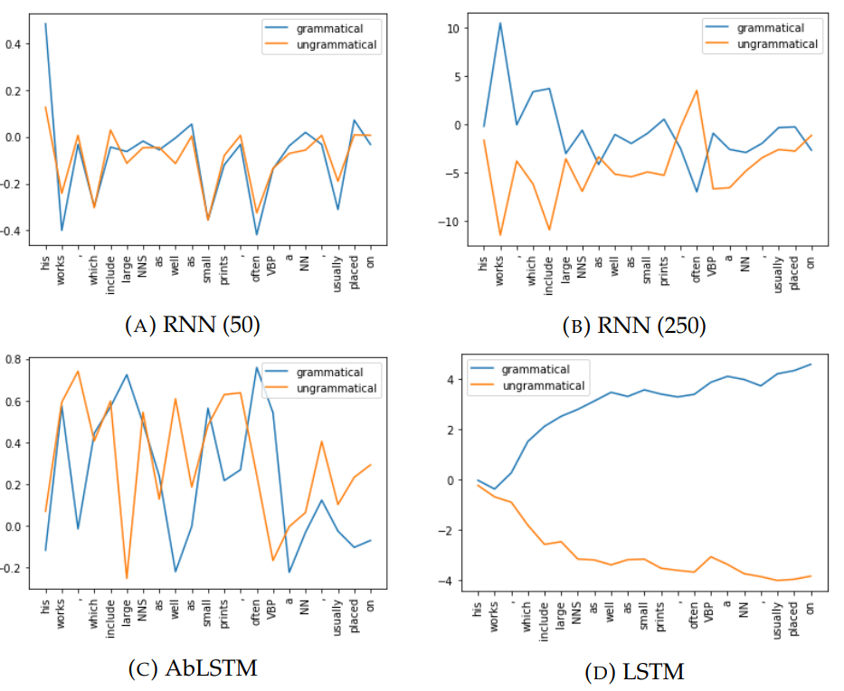
Plus 6
His works, which include large NNS(murals) as well as small prints, often VBP(depict) a NN(teapot), usually placed on

Slide 52
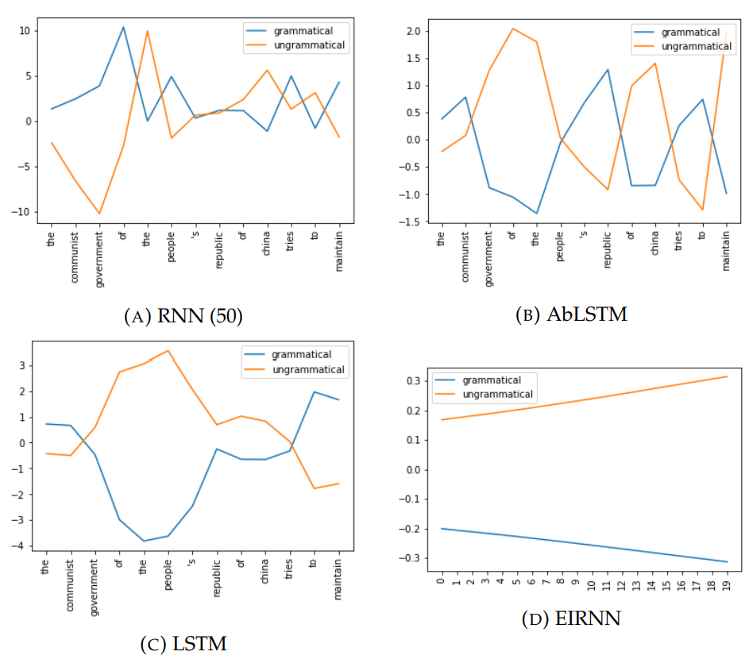
Plus 2
The communist government of the People’s Republic of China tries to maintain

Slide 53
Some errors appear to be due to difficulty not in identifying the subject but in determining whether it is plural or singular.
Its current headquarters is in Rabat, Morocco.
Some verbs that are ambiguous with plural nouns or nouns in general seem to have been misanalyzed as plural nouns and consequently act as attractors.
Every arrow that flies feels the pull of (the earth).

Slide 54
 | EIRNN | LSTM
NN | 3368 | 954
NNS | 1470 | 1997
NN NN | 1177 | 261
NN NNS | 432 | 5619
NNP NN | 349 | 316
NN NN NN | 315 | 87
PRP$ NN | 298 | 123
NN NNP | 213 | 330
NNP NNS | 187 | 443
NNS NNS | 175 | 119
NNS NN | 168 | 5758
 | EIRNN | LSTM
NNS NN | 168 | 5758
NN NN NNS | 97 | 2691
NN NNS NN | 51 | 1295
NN NNS | 432 | 5619
NN NN NN NNS | 25 | 1053
NN NNS NNS | 33 | 841
NNP NN NNS | 58 | 602
NNS NNS NN | 15 | 597
NN NNP NNS | 14 | 486
NNP NNS | 187 | 483
NN NN NN NN NNS | 12 | 418

Slide 55
Examples & Analysis
EIRNN not LSTM | LSTM not EIRNN
2272 unique ; 13941 total points NN : 3368 NNS : 1470 NN NN : 1177 NN NNS : 432 NNP NN : 349 NN NN NN : 315 PRP$ NN : 298 NN NNP : 213 NNP NNS : 187 NNS NNS : 175 NNS NN : 168 PRP NN : 135 PRP$ NNS : 125 NNP NN NN : 123 NN NN NN NN : 119 NNP NNP NN : 115 NN NNP NNP : 105 NN NN NNS : 97 NN PRP : 72 NNS NNP : 70 | 23313 unique ; 84039 total points NNS NN : 5758 NN NNS : 5619 NN NN NNS : 2619 NNS NN NN : 2092 NNS : 1997 NN NNS NN : 1295 NN NN NN NNS : 1053 NN : 954 NN NNS NNS : 841 NNP NN NNS : 602 NNS NNS NN : 597 NNS NN NN NN : 594 NNS NNP NNP : 576 NNS NNP NN : 496 NN NNP NNS : 486 NNS NNP : 457 NN NNS NN NN : 451 NNP NNS : 443 NNP NNS NN : 439 NN NN NN NN NNS : 418

Slide 56
Before Extra Slides

Slide 57
EIRNN not RNN | RNN not EIRNN
4679 unique ; 14142 total points NN NNS : 788 NNS NN : 740 NN NN NNS : 524 NNS : 497 NN : 328 NN NN NN NNS : 238 NNS NN NN : 220 NN NNS NN : 202 NN NN : 134 NN NNP : 132 NN NNS NNS : 130 NNP NNS : 119 NNS NNP : 110 NN PRP : 109 NNS NNS : 100 | 19849 unique ; 66153 total points NNS NN : 4635 NN NNS : 4475 NN NN NNS : 2156 NNS : 1605 NNS NN NN : 1494 NN NNS NN : 999 NN NN NN NNS : 865 NN : 816 NN NNS NNS : 505 NNS NNP NNP : 501 NNS NNS NN : 500 NNP NN NNS : 489 NNS NNP NN : 390 NNS NNP : 386 NN NNP NNS : 372

Slide 58
Example Sentences (EIRNN vs LSTM)
EIRNN (not LSTM)
the layout of the hotel is (also similar to the one used in bottle rocket)
the full source code for the game is (now available on NNS in the NN on NNP programming)
no evidence as to why this level crossing is (notable)
LSTM (not EIRNN)
the details depend upon whether the wave is (purely JJ , purely electromagnetic , or neither .)
the place for japanese characters is (in the japanese wp , like .)
all original research and no secondary sources available online , even though this is a recent NN

Slide 59
Ablated LSTM Models
LSTM :
i = sigma(W_{ii} x + b_{ii} + W_{hi} h + b_{hi})
f = sigma(W_{if} x + b_{if} + W_{hf} h + b_{hf})
g = tanh(W_{ig} x + b_{ig} + W_{hg} h + b_{hg})
o = sigma(W_{io} x + b_{io} + W_{ho} h + b_{ho})
c' = f * c + i * g
h' = o * tanh(c')
Ablated LSTM :
g = tanh(W_{ig} x + b_{ig} + W_{hg} h + b_{hg})
o = sigma(W_{io} x + b_{io} + W_{ho} h + b_{ho})
h' = o * tanh(c')
Scalar : c' = ((1-ɑ) * c) + (ɑ * g)
ɑ is a scalar (real valued).
Vector : c' = (f * c) + (i * g)
i, f are vector parameters learned by the model.

Slide 60
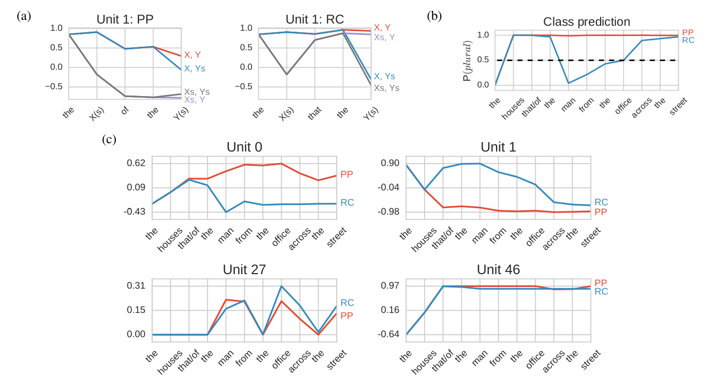
Activations Analysis and Replication
Assessing the Ability of LSTMs to Learn Syntax-Sensitive Dependencies: Linzen, ACL 2016

